Slide 1
Decision Making Under Uncertainty
Payoff Table
Decision Trees
The Precision Tree Add-In
Bayes` Rule
Utility Based Decisions

Slide 2
Introduction
A formal framework for analyzing decision problems that involve uncertainty includes:
Criteria for choosing among alternative decisions
How probabilities are used in the decision-making process
How early decisions affect decisions made at a later stage
How a decision maker can quantify the value of information
How attitudes toward risk can affect the analysis
A powerful graphical tool—a decision tree—guides the analysis.
A decision tree enables a decision maker to view all important aspects of the problem at once: the decision alternatives, the uncertain outcomes and their probabilities, the economic consequences, and the chronological order of events.

Slide 3
Elements of Decision Analysis
In decision making under uncertainty, all problems have three common elements:
The set of decisions (or strategies) available to the decision maker
The set of possible outcomes and the probabilities of these outcomes
A value model that prescribes monetary values for the various decision-outcome combinations
Once these elements are known, the decision maker can find an optimal decision, depending on the optimality criterion chosen.

Slide 4
Payoff Tables
The listing of payoffs for all decision-outcome pairs is called the payoff table.
Positive values correspond to rewards (or gains).
Negative values correspond to costs (or losses).
A decision maker gets to choose the row of the payoff table, but not the column.
A “good” decision is one that is based on sound decision-making principles—even if the outcome is not good.

Slide 5
Possible Decision Criteria
Maximin criterion—finds the worst payoff in each row of the payoff table and chooses the decision corresponding to the best of these.
Appropriate for a very conservative (or pessimistic) decision maker
Tends to avoid large losses, but fails to even consider large rewards.
Is typically too conservative and is seldom used.
Maximax criterion—finds the best payoff in each row of the payoff table and chooses the decision corresponding to the best of these.
Appropriate for a risk taker (or optimist)
Focuses on large gains, but ignores possible losses.
Can lead to bankruptcy and is also seldom used.

Slide 6
Expected Monetary Value (EMV)
The expected monetary value, or EMV, for any decision is a weighted average of the possible payoffs for this decision, weighted by the probabilities of the outcomes.
The expected monetary value criterion, or EMV criterion, is generally regarded as the preferred criterion in most decision problems.
This approach assesses probabilities for each outcome of each decision and then calculates the expected payoff, or EMV, from each decision based on these probabilities.
Using this criterion, you choose the decision with the largest EMV—which is sometimes called “playing the averages.”

Slide 7
Example: Investment Projects
Investment A |  | Investment B
Cash Inflows, AZN | Probability | Cash Inflows, AZN | Probability
6,000 | 0.25 (0.2) | 5,000 | 0.3
8,000 | 0.50 (0.55) | 9,000 | 0.5
10,000 EMV A =8,000 | 0.25 | 10,000 EMV B =8,000 | 0.2
EMV A =6,000*0.2+8,000*0.55+10,000*0.25=8,100

Slide 8
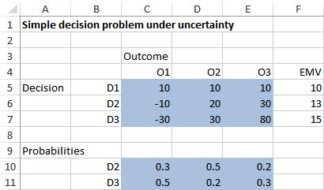
Sensitivity Analysis
It is important, especially in real-world business problems, to accompany any decision analysis with a sensitivity analysis.
In sensitivity analysis, we systematically vary inputs to the problem to see how (or if) the outputs—the EMVs and the best decision—change.

Slide 9
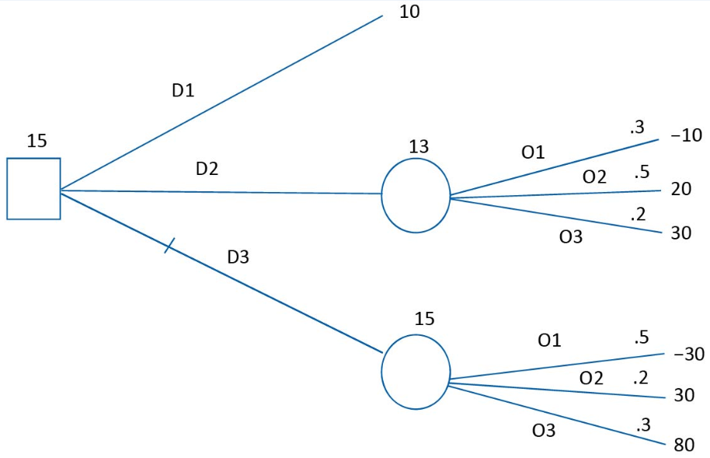
Decision Trees (slide 1 of 4)
A graphical tool called a decision tree has been developed to represent decision problems.
It is particularly useful for more complex decision problems.
It clearly shows the sequence of events (decisions and outcomes), as well as probabilities and monetary values.

Slide 10
Decision Trees (slide 2 of 4)
Decision trees are composed of nodes (circles, squares, and triangles) and branches (lines).
The nodes represent points in time. A decision node (a square) represents a time when the decision maker makes a decision.
A chance node (a circle) represents a time when the result of an uncertain outcome becomes known.
An end node (a triangle) indicates that the problem is completed—all decisions have been made, all uncertainty has been resolved, and all payoffs and costs have been incurred.
Time proceeds from left to right. Any branches leading into a node (from the left) have already occurred. Any branches leading out of a node (to the right) have not yet occurred.

Slide 11
Decision Trees (slide 3 of 4)
Branches leading out of a decision node represent the possible decisions; the decision maker can choose the preferred branch.
Branches leading out of chance nodes represent the possible outcomes of uncertain events; the decision maker has no control over which of these will occur.
Probabilities are listed on chance branches. These probabilities are conditional on the events that have already been observed (those to the left).
Probabilities on branches leading out of any chance node must sum to 1.
Monetary values are shown to the right of the end nodes.
EMVs are calculated through a “folding-back” process. They are shown above the various nodes.

Slide 12
Decision Trees (slide 4 of 4)
The decision tree allows you to use the following folding-back procedure to find the EMVs and the optimal decision:
Starting from the right of the decision tree and working back to the left:
At each chance node, calculate an EMV—a sum of products of monetary values and probabilities.
At each decision node, take a maximum of EMVs to identify the optimal decision.
The PrecisionTree add-in does the folding-back calculations for you.

Slide 13
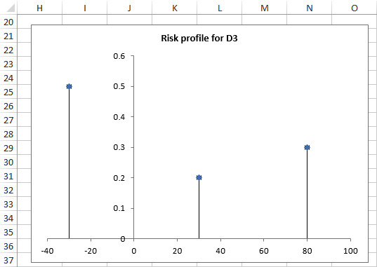
Risk Profiles
The risk profile for a decision is a “spike” chart that represents the probability distribution of monetary outcomes for this decision.
By looking at the risk profile for a particular decision, you can see the risks and rewards involved.
By comparing risk profiles for different decisions, you can gain more insight into their relative strengths and weaknesses.

Slide 14
Example 6.1: SciTools Bidding Decision 1.xlsx (slide 1 of 3)
Objective: To develop a decision model that finds the EMV for various bidding strategies and indicates the best bidding strategy.
Solution: For a particular government contract, SciTools Incorporated estimates that the possible low bids from the competition, and their associated probabilities, are those shown below.
SciTools also believes there is a 30% chance that there will be no competing bids.
The cost to prepare a bid is $5000, and the cost to supply the instruments if it wins the contract is $95,000.

Slide 15
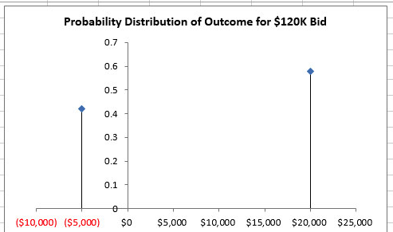
Example 6.1: SciTools Bidding Decision 1.xlsx (slide 2 of 3)

Slide 16
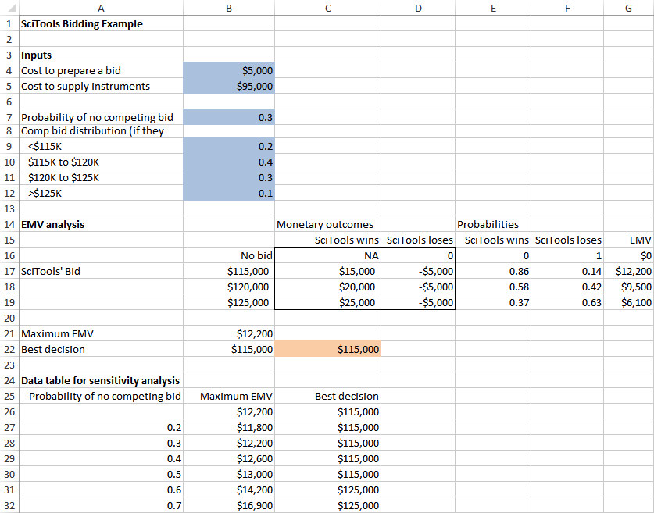
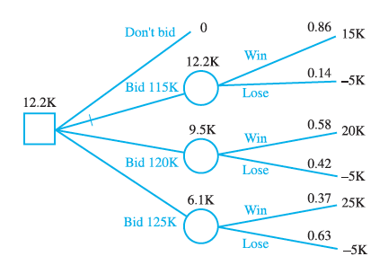
Example 6.1: SciTools Bidding Decision 1.xlsx (slide 3 of 3)

Slide 17
The PrecisionTree Add-In
Decision trees present a challenge for Excel®.
PrecisionTree, a powerful add-in developed by Palisade Corporation, makes the process relatively straightforward.
It enables you to draw and label a decision tree.
It performs the folding-back procedure automatically.
It allows you to perform sensitivity analysis on key input parameters.
Up to four types of charts are available, depending on the type of sensitivity analysis.

Slide 18
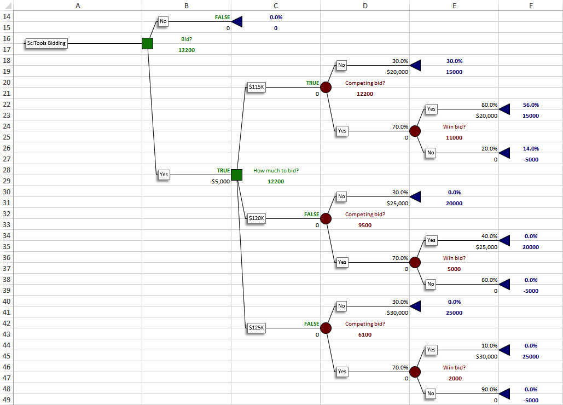
Completed Tree from PrecisionTree

Slide 19
Bayes’ Rule (slide 1 of 3)
In a multistage decision tree, all chance branches toward the right of the tree are conditional on outcomes that have occurred earlier, to their left.
The probabilities on these branches are of the form P(A|B), where A is an event corresponding to a current chance branch, and B is an event that occurs before event A in time.
It is sometimes more natural to assess conditional probabilities in the opposite order, that is, P(B|A).
Whenever this is the case, Bayes’ rule must be used to obtain the probabilities needed on the tree.

Slide 20
Bayes’ Rule (slide 2 of 3)
To develop Bayes’ rule, let A₁ through A_{n} be any outcomes.
Without any further information, you believe the probabilities of the As are P(A₁) through P(A_{n}). These are called prior probabilities.
Assume the probabilities of B, given that any of the As will occur, are known. These probabilities, labeled P(B|A₁) through P(B|An) are often called likelihoods.
Because an information outcome might influence your thinking about the probabilities of the As, you need to find the conditional probability P(A_{i}|B) for each outcome A_{i}. This is called the posterior probability of A_{i}.

Slide 21
Bayes’ Rule (slide 3 of 3)
Bayes’ rule states that the posterior probabilities can be calculated with the following formula:
In words, Bayes’ rule says that the posterior is the likelihood times the prior, divided by a sum of likelihoods times priors.
As a side benefit, the denominator in Bayes’ rule is also useful in multistage decision trees. It is the probability P(B) of the information outcome.
This formula is important in its own right. For B to occur, it must occur along with one of the As.
The equation simply decomposes the probability of B into all of these possibilities. It is sometimes called the law of total probability.

Slide 22
Multistage Decision Problems and the Value of Information
In many multistage decision problems, the first-stage decision is whether to purchase information that will help make a better second-stage decision.
The information, if obtained, typically changes the probabilities of later outcomes.
To revise the probabilities once the information is obtained, you often need to apply Bayes’ rule.
In addition, you typically want to learn how much the information is worth.

Slide 23
The Value of Information (slide 1 of 2)
Information that will help you make your ultimate decision should be worth something, but it might not be clear how much the information is worth.
Sample information is the information from the experiment itself.
A more precise term would be imperfect information.
Perfect information is information from a perfect test—that is, a test that will indicate with certainty which ultimate outcome will occur.
Perfect information is almost never available at any price, but finding its value is useful because it provides an upper bound on the value of any information.

Slide 24
The Value of Information (slide 2 of 2)
The expected value of sample information, or EVSI, is the most you would be willing to pay for the sample information.
The expected value of perfect information, or EVPI, is the most you would be willing to pay for perfect information.
The amount you should be willing to spend for information is the expected increase in EMV you can obtain from having the information.
If the actual price of the information is less than or equal to this amount, you should purchase it; otherwise, the information is not worth its price.
Information that never affects your decision is worthless.
The value of any information can never be greater than the value of perfect information that would eliminate all uncertainty.

Slide 25
Risk Aversion and Expected Utility
Rational decision makers are sometimes willing to violate the EMV maximization criterion when large amounts of money are at stake.
These decision makers are willing to sacrifice some EMV to reduce risk.
Most researchers believe that if certain basic behavioral assumptions hold, people are expected utility maximizers—that is, they choose the alternative with the largest expected utility.

Slide 26
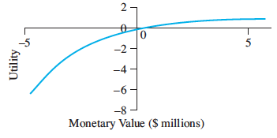
Utility Functions
Utility function is a mathematical function that transforms monetary values—payoffs and costs—into utility values.
An individual’s utility function specifies the individual’s preferences for various monetary payoffs and costs and, in doing so, it automatically encodes the individual’s attitudes toward risk.
Most individuals are risk averse, which means intuitively that they are willing to sacrifice some EMV to avoid risky gambles.
The resulting utility functions are shaped as shown below:

Slide 27
Exponential Utility
Classes of ready-made utility functions have been developed to help assess people’s utility functions.
An exponential utility function has only one adjustable numerical parameter, called the risk tolerance.
There are straightforward ways to discover an appropriate value of this parameter for a particular individual or company, so it is relatively easy to assess.
An exponential utility function has the following form:
The risk tolerance for an exponential utility function is a single number that specifies an individual’s aversion to risk.
X – monetary value of the payoff or cost, R – risk tolerance (indifference between no payoff and payoff of R or R/2 loss)
The higher the risk tolerance, the less risk averse the individual is.

Slide 28
Example 6.5: Using Exponential Utility.xlsx (slide 1 of 2)
Objective: To see how the company’s risk averseness, determined by its risk tolerance in an exponential utility function, affects its decision.
Solution: Venture Limited must decide whether to enter one of two risky ventures or invest in a sure thing.
The gain from the latter is a sure $125,000.
The possible outcomes of the less risky venture are a $0.5 million loss, a $0.1 million gain, and a $1 million gain. The probabilities of these outcomes are 0.25, 0.50, and 0.25, respectively.
The possible outcomes of the more risky venture are a $1 million loss, a $1 million gain, and a $3 million gain. The probabilities of these outcomes are 0.35, 0.60, and 0.05, respectively.
Assume that Venture Limited has an exponential utility function. Also assume that the company’s risk tolerance is 6.4% of its net sales, or $1.92 million.
Use PrecisionTree to develop the decision tree model.

Slide 29
Example 6.5: Using Exponential Utility.xlsx (slide 2 of 2)

Slide 30
Example: Investment Projects
Investment A |  | Investment B
Cash Inflows, AZN | Probability | Cash Inflows, AZN | Probability
6,000 | 0.25 | 5,000 | 0.3
8,000 | 0.50 | 9,000 | 0.5
10,000 EMV A =8,000 | 0.25 | 10,000 EMV B =8,000 | 0.2
Money 5,000 6,000 7,000, 8,000 9,000 10,000 Utility (Utils) 125 145 162 175 185 194 U(A)=145*0.25+175*0.5+194*0.25=172.25 U(B)=125*0.3+185*0.5+194*0.2=168.8

Slide 31
Is Expected Utility Maximization Used?
Expected utility maximization is a fairly involved task.
Theoretically, it might be interesting to researchers.
However, in the business world, it is not used very often.
Risk aversion has been found to be of practical concern in only 5% to 10% of business decision analyses.
It is often adequate to use expected value (EMV) for most decisions.

